Slide 1
ULI101: Introduction to Unix / Linux and the Internet Week1: lesson 1 Course Introduction / Unix and Linux Background ACCESSING YOUR Linux Matrix server account
Photos and icons used in this slide show are licensed under CC BY-SA

Slide 2
Lesson 1 topics
Why I Am Taking This Course? (Course Introduction)
Instructor Information / Purpose of Course
Foundations For Future Courses (Programming, Networking)
Course Resources / Course Outline / Course Policies
Background and Features of UNIX and LINUX OS
Purpose of an OS / History of Unix & Linux OS
Features of Unix / Linux OS
Matrix Linux Server
Purpose / Layout
How to Access your Matrix Linux Account:
From Seneca Lab Workstation
From Laptop or Home Computer (Windows, Mac OSX, Linux)
How to Logout of your Matrix Linux Account

Slide 3
Course Introduction
Why Am I Taking This Course?
Regardless of the IT program that you are currently registered in, there are important technical skills that you must learn in order to be successful in future courses for your program.
In this course, you will learn core utilities to work productively in a Unix / Linux operating system environment including the following topics:
Issuing Linux commands and utilities
Manipulating data stored in regular text files
Managing files and directories (including access & permissions)
Writing basic shell scripts
Configuring login accounts

Slide 4
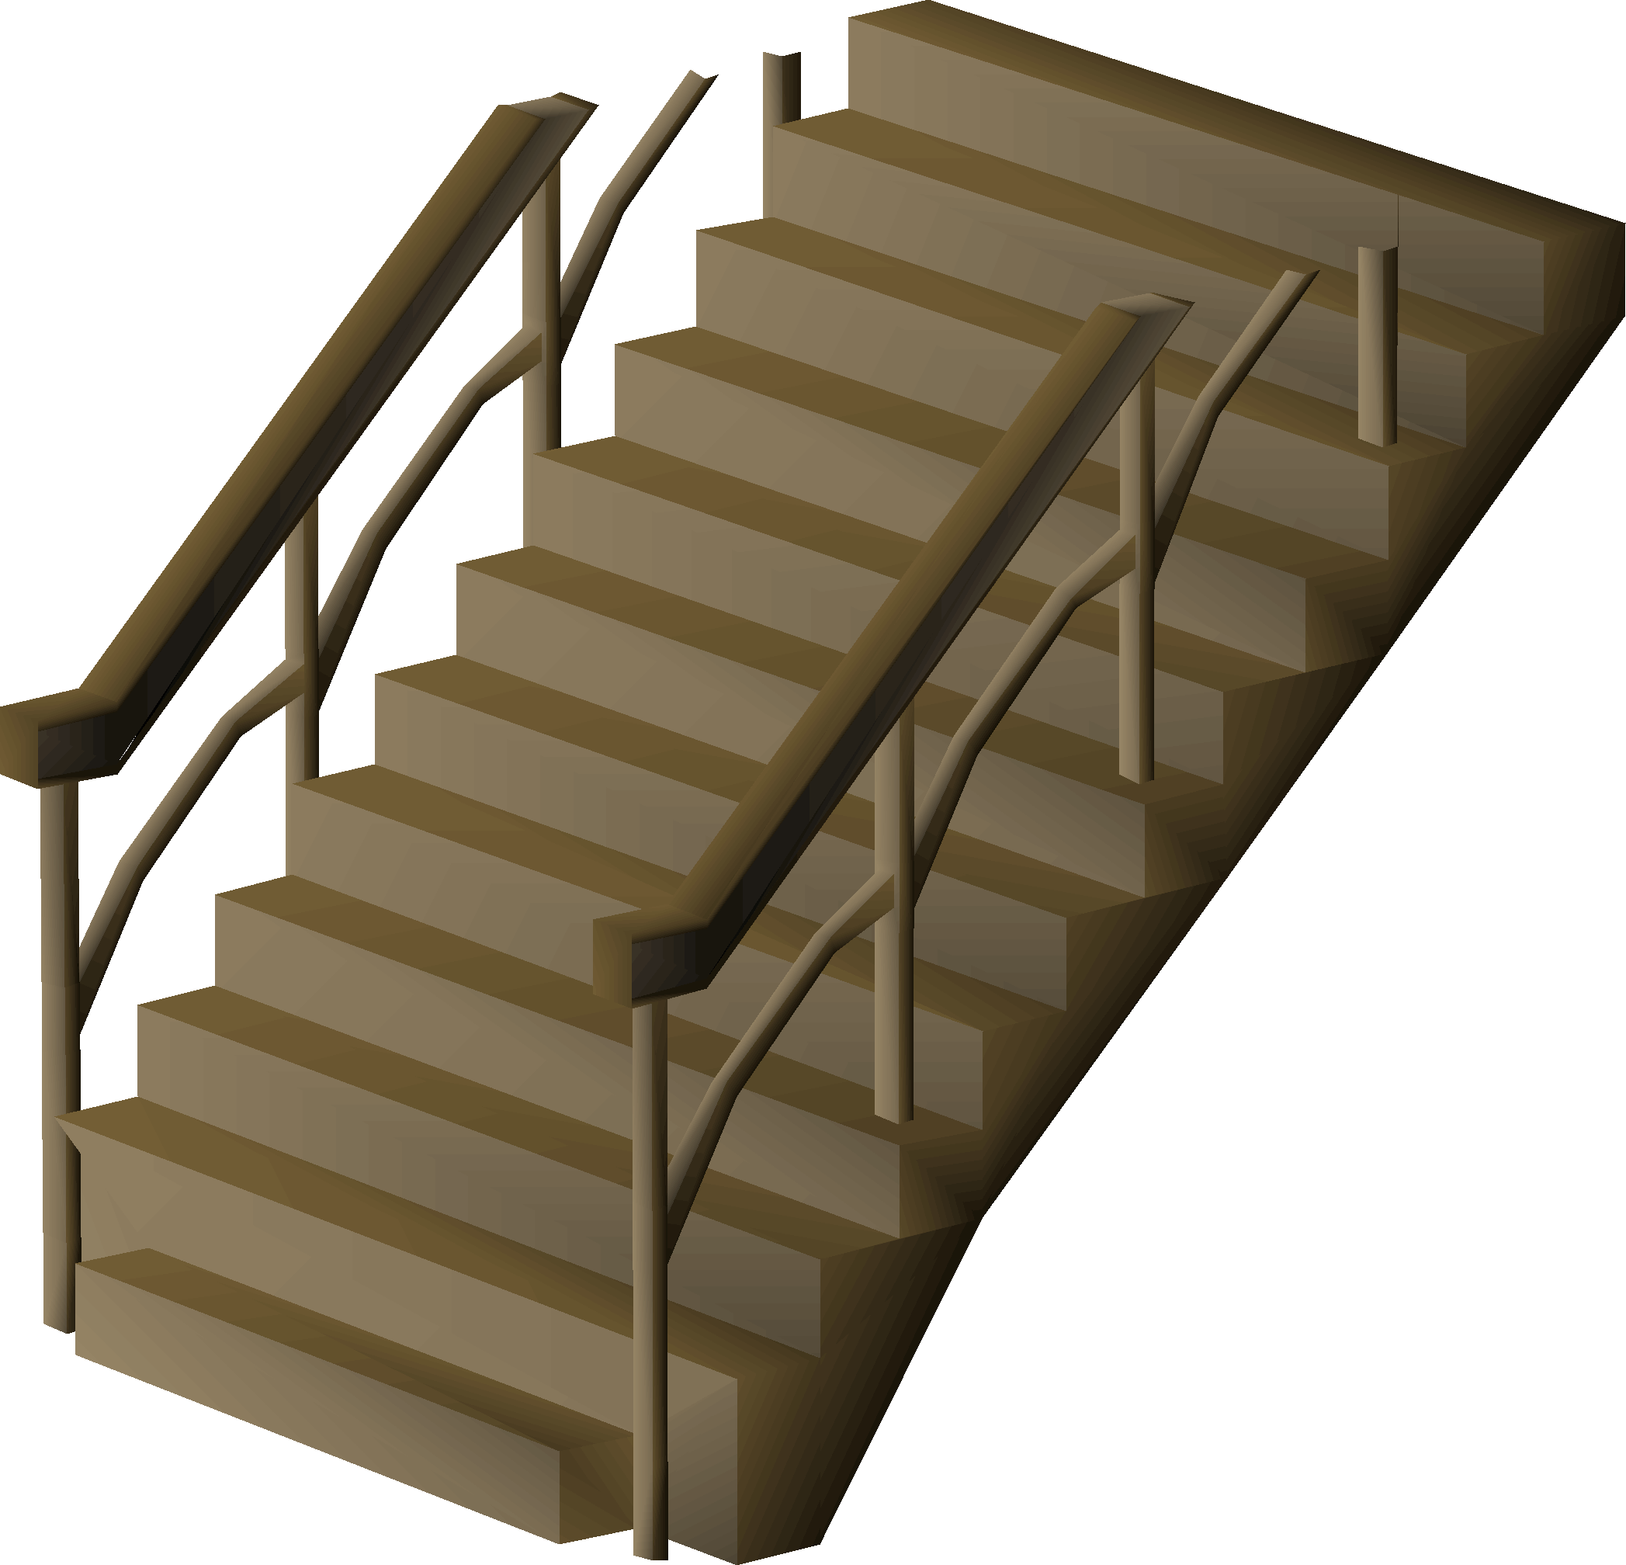
Course Introduction
Foundation for Future Courses
The following table shows the various courses that require Linux skills for the networking & tech support / programming streams.
Networking / Tech Support Stream | Programming Stream
OPS245 (Intro to Linux Admin) OPS345 (Network Admin) OPS435 (Linux Admin Automation) NDD430 (Network Diagnostics & Design) OPS535 (Advanced Network Admin) OPS635 (Enterprise Management) + Pro-Option Courses | IPC144 (Intro to Programming) OOP244 (Object Oriented Programming I) OOP345 (Object Oriented Programming II) WEB322 (Web Programming Tools) WEB422 (Web Programming Apps & Services) JAC444 (Intro to Java) + Pro-Option Courses

Slide 5
Course Introduction
Course Resources
Resources | Purpose
ULI101 Website: https://ict.senecacollege.ca/~uli101/ ULI101 WIKI (preferred): https://wiki.cdot.senecacollege.ca/wiki/ULI101 | Course Outline / Course Policies Weekly Schedule (notes, tutorials, practice questions) Assignment Instructions
Learning Content Management System (Blackboard) https://my.senecacollege.ca/ | Course Marks (located in My Grades) Link to the ULI101 WIKI Online Quizzes / Online Tests
The Linux Documentation Project http://en.tldp.org/ | Vast online Linux Documentation HOWTOs, Guides, FAQs

Slide 6
Course Introduction
Faculty Information
Please note and record the following information in class:
Prof. John Smith
How to Contact ULI101 Instructor:
Via E-mail: john.smith@senecacollege.ca
Via Teams – In Classroom Group or 1-on-1

Slide 7
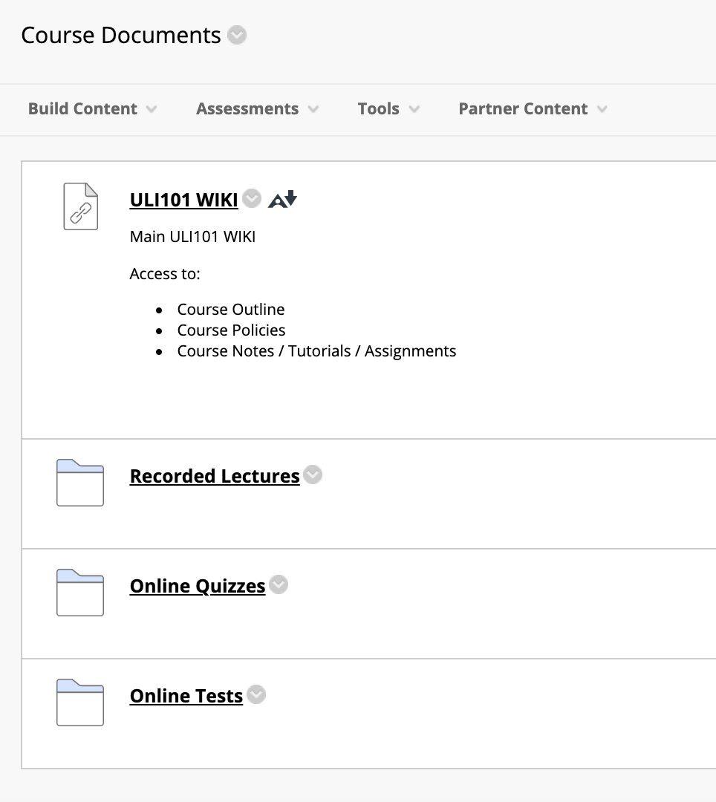
Course Introduction
Blackboard: Course Documents In the Course Documents section of your Blackboard ULI101 course, there are several resources which include:
A Link to the ULI101 WIKI that contains weekly lesson slides and hands-on tutorials.
Recorded Lectures are recorded live and saved as a streaming video which becomes available a few hours after the lecture.
Online Quizzes contain online quizzes for this course.
Online Tests contain the midterm (test1) and final exam (test2) for this course.

Slide 8
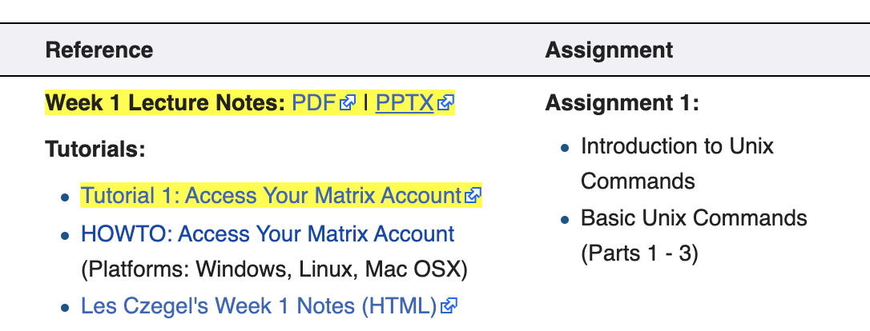
Course Introduction
ULI101 WIKI
Main WIKI Page (Quick Links)
The Quick Links section on the top-right corner provide links to the weekly schedule, course outline, course policies and assignment instructions
Weekly Schedule Page
The weekly Schedule provides lecture notes (under Reference section in both PDF and PowerPoint format). The Tutorials section contains a weekly hands-on tutorial that provide the student-guided practice to become familiar with working in the Linux environment. Depending on your instructor, these tutorials may require successfully completion within a deadline for marks.
NOTE: It is RECOMMENDED to perform areas highlighted in YELLOW

Slide 9
Course Introduction
Course Outline
Link: https://ict.senecacollege.ca/course/uli101/
Topics
Course Description
Modes of Instruction
Evaluation / Promotion Policy
Learning Outcomes / Topic Outline

Slide 10
Course Introduction
Course Policies
Link: https://wiki.cdot.senecacollege.ca/wiki/Course_Policies_for_ULI101
Topics
Assignments
Quizzes, Midterm Test, and Examination
Cheating & Plagiarism
What constitutes cheating?
General Information

Slide 11
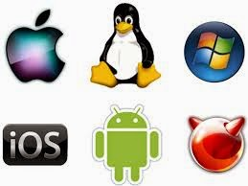
UNIX and LINUX Background and features
Purpose of an Operating System
An operating system basically performs 2 major tasks:
Manages Resources to provide a platform for application to run
Interface to allow the OS to communicate with the end-user (Humans)
Over time, operating systems used a command line interface, then evolved into a menu-driven interface, then finally a graphical user interface (GUI).
Depending on the OS installation setup, modern operating systems can provide ALL of the above-named types of interfaces to help accommodate all users’ preferences.

Slide 12
UNIX and LINUX Background and features
History of Unix
Although Unix was not the first operating system, it made a huge impact in the 70’s and is still a popular OS today.
Interesting Facts:
The UNIX OS was developed in the early 70’s by Ken Thompson as a platform to play a crude network strategy-based game called “space travel”.
UNIX was developed at AT&T Bell labs, but it took the company a few years to realize that this OS would be popular and marketed proprietary version that became Unix System V (release 4).
While Ken Thompson took a break from work and taught at University of Berkley California, he provided students source code to OS and Shell (interface) which branched into a free version of the OS that became BSD (Berkley Software Distribution) Unix.

Slide 13
UNIX and LINUX Background and features
History of Unix / Continued…
Unix was developed to incorporate the following features:
Allows for multiple users – this is performed by assigning each user a “small slice of time” to give illusion that computer is paying total attention to that user.
Allows for multi-tasking – allows for more than one task to be executed at the same time (e.g. via a “time-slice”).
Supports multi-processing (allows tasks to be performed on multiple processors).
Simplifies sharing of data and programs among users.
Unix also evolved at the time that ARPANET (an ancestor to the Internet) was evolving which made it easier to setup computer networks and use networking and eventually Internet related utilities.

Slide 14
UNIX and LINUX Background and features
History of Unix / Continued…
Unix was re-written using the C programming language to make the OS more portable to install and operated on other types of computers.
Hardware manufacturers modified UNIX to run on their systems and added enhancements.
Versions of Unix (both propriety and free) became standardized to be accepted and used by industry and government organizations (e.g. POSIX standard).

Slide 15
UNIX and LINUX Background and features
History of GNU / Linux
Richard Stallman published the GNU Manifesto in 1984, which described the need for Free Software ("Free in the sense of free speech, not free beer"). The resultant GNU project developed free, open-source replacements for most of the Unix programs, but not for the Unix kernel (the core program that interacted with and controlled the hardware).
These programs were released under the GNU General Public License (GPL), which permits anyone to copy, use, and modify the software, as long as these rights are preserved for anyone receiving a subsequent copy of the software.
Under the GNU project, there were many free utilities that were available for a Unix-Like OS, but the Unix-like OS for PCs that Richard was developing was not stable and another Unix-like OS for the PCs became available called Linux.

Slide 16
UNIX and LINUX Background and features
History of GNU / Linux (Continued…)
In 1991, Linus Torvalds, a Finnish computer programming student, released the Linux kernel, eventually placing it under the GPL.
The Linux kernel, GNU software, and some other components were combined into a powerful, Unix-like operating system.
This OS can’t technically be called Unix, because it has never been certified to be Unix, but virtually everyone in the industry regards it as such.
The combined GNU and Linux system is called “GNU/Linux” by some but just “Linux” by others (much to the dismay of Richard Stallman) who feels that the simple name Linux downplays the tremendous contribution made by the GNU Project.

Slide 17
Matrix Linux Server
While attending Seneca College, you will be using many different computer systems to perform various operations. Below is a listing of a few of these servers:
Students will mainly use a web-browser to interact with those listed servers.
An exception is the Matrix server which requires that students run an application to connect to their server account to practice Linux commands, perform tutorials and submit their online assignments.
my.senecacollege.ca | Learning Content Management System (Student Grades / Notes / Online Quizzes)
ict.senecacollege.ca | Main ICT Webserver
wiki.cdot.senecacollege.ca | Course WIKIs for Seneca College Students
matrix.senecacollege.ca | Linux Account for Student Practice and Assignment submission

Slide 18
Matrix Linux Server
The Matrix server consists of several Virtual Computers connected to form a cluster. A cluster is a cost effective alternative to buying larger servers.
All registered students in this course have access to an account on the Matrix server. You will be using this account for the following reasons:
Issuing Linux commands
Practicing Linux commands at the Linux shell to be more productive
Performing Linux Online Tutorials (12)
Performing Linux Online Assignments (3)
Practice Issuing Linux Command Review Questions

Slide 19
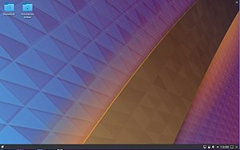
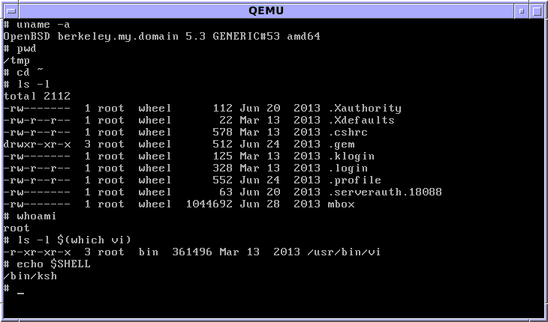
Matrix Linux Server
Communicating with Matrix Server In UNIX / LINUX, a shell refers to an interface that allows a user to communicate with the OS.
UNIX / LINUX has the ability to install a GUI (Graphical User Interface) that allows the user to launch applications via icons, graphically manage files, etc.
On the other hand, due to bandwidth issues and the large number of Seneca students that remotely connect to the Matrix server, it is NOT feasible to connect via a GUI.
Therefore, it is only possible to interface with your Matrix account via a CLI (Command Line Interface), where students issue Linux commands to launch applications, manage files, etc...

Slide 20
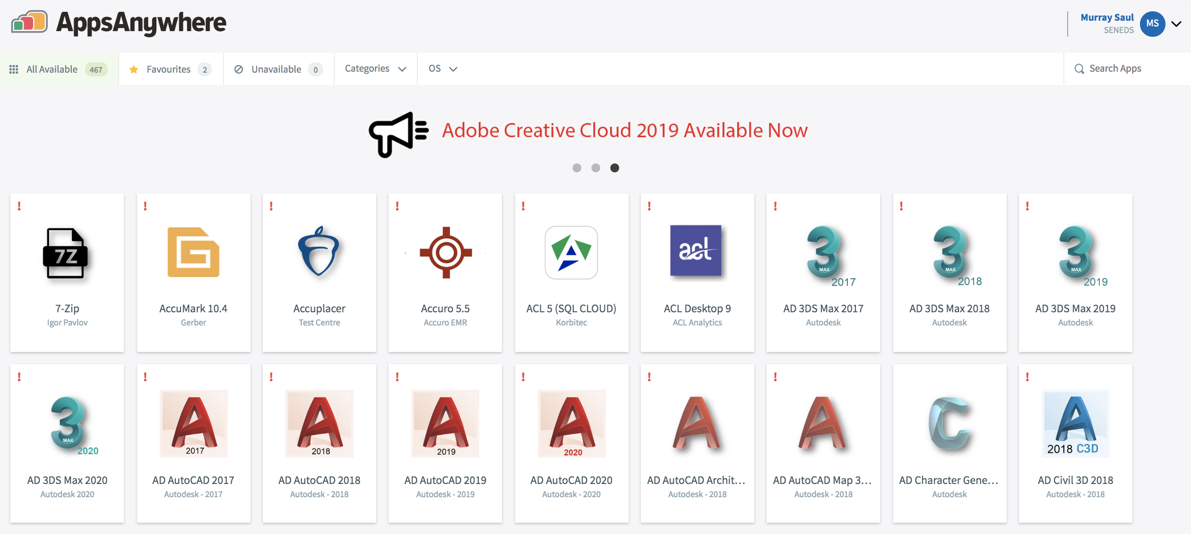
Matrix Linux Server
Accessing Matrix from Within College:
You can access your Matrix Linux account from a workstation located in any Seneca lab, or from your own computer (e.g. laptop or home computer).
Accessing Matrix from Lab Workstation:
MyApps is an application streaming service that lets you run software on any Seneca Workstation on demand. Any software application on the MyApps menu can be used on computers in classrooms, labs, and the Computing Commons.
Reference: https://inside.senecacollege.ca/its/software/myapps/

Slide 21
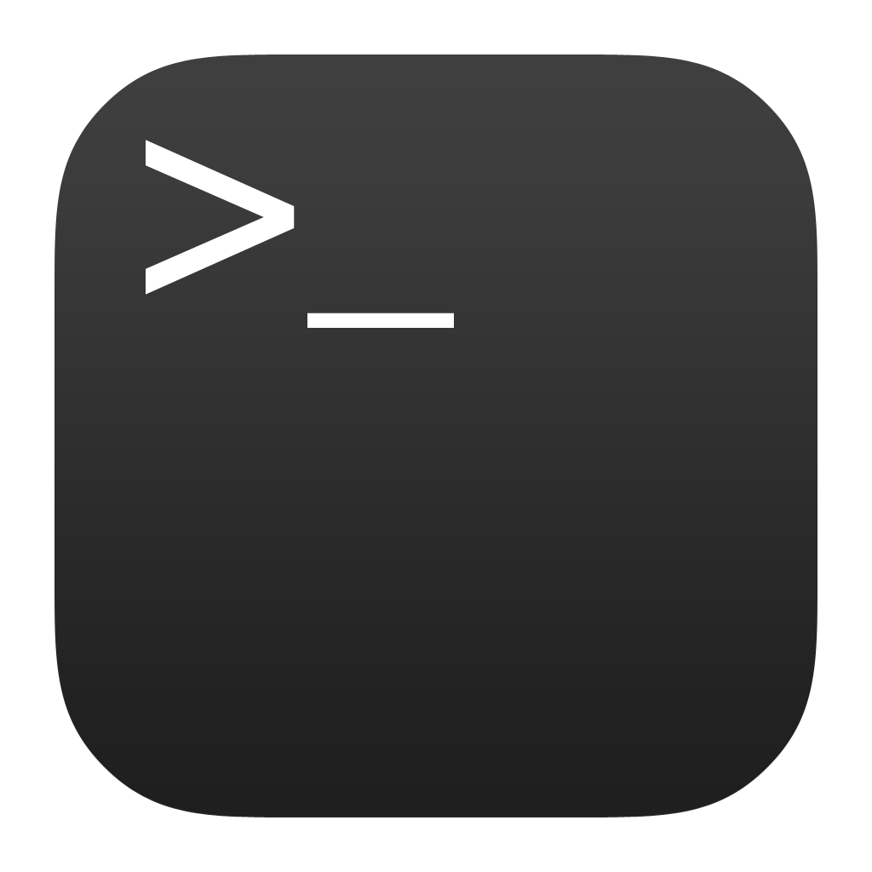
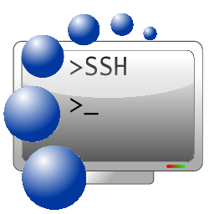
Matrix Linux Server
Accessing Matrix from Remote Computer:
Due to the COVID19 Pandemic, ICT students are required to learn remotely (i.e. not at Seneca College).
You can also do this by command-line (eg. ssh command) or by running a graphical SSH application (eg. SSH Secure Shell Client).

Slide 22
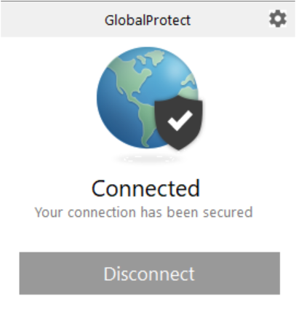
Matrix Linux Server
Connecting to the Seneca GlobalProtect Student VPN As of September 2020, all Seneca College students are required to FIRST connect to the Seneca GlobalProtect Student VPN in order to be able to connect to their Matrix Linux account. Seneca College are "rolling-out" additional measures to improve network security. One of these measures are to implement multi-factored authentication.
Multi-factor authentication is an electronic authentication method in which a computer user is granted access to a website or application only after successfully presenting two or more pieces of evidence (or factors) to an authentication mechanism: knowledge (something the user and only the user knows). Reference: https://en.wikipedia.org/wiki/Multi-factor_authentication NOTE: If you haven't done this yet, please perform the steps provided in the following link: https://employees.senecacollege.ca/spaces/77/it-services/wiki/view/3716/vpn

Slide 23
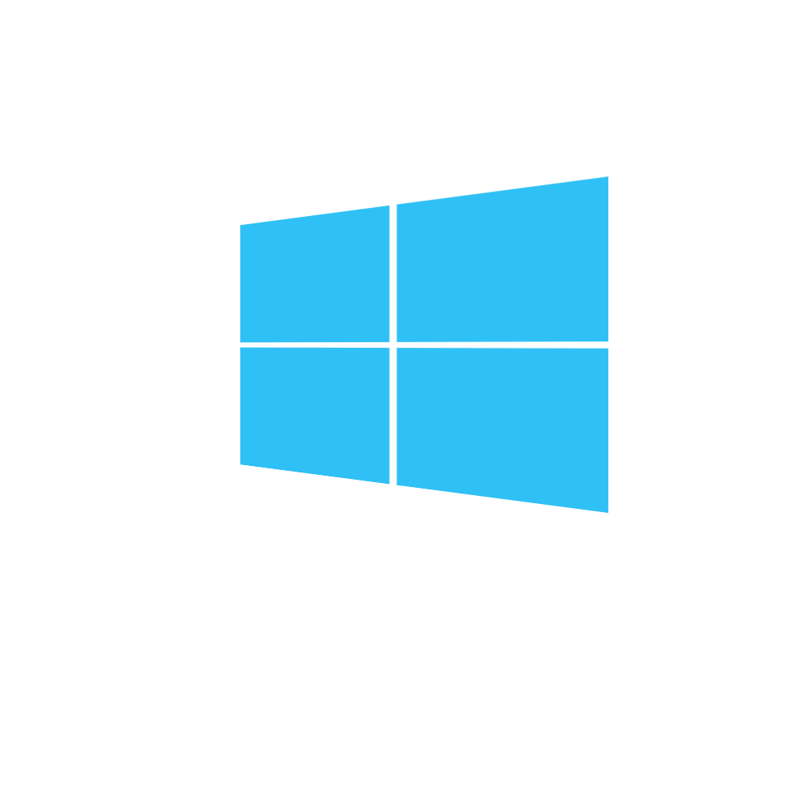
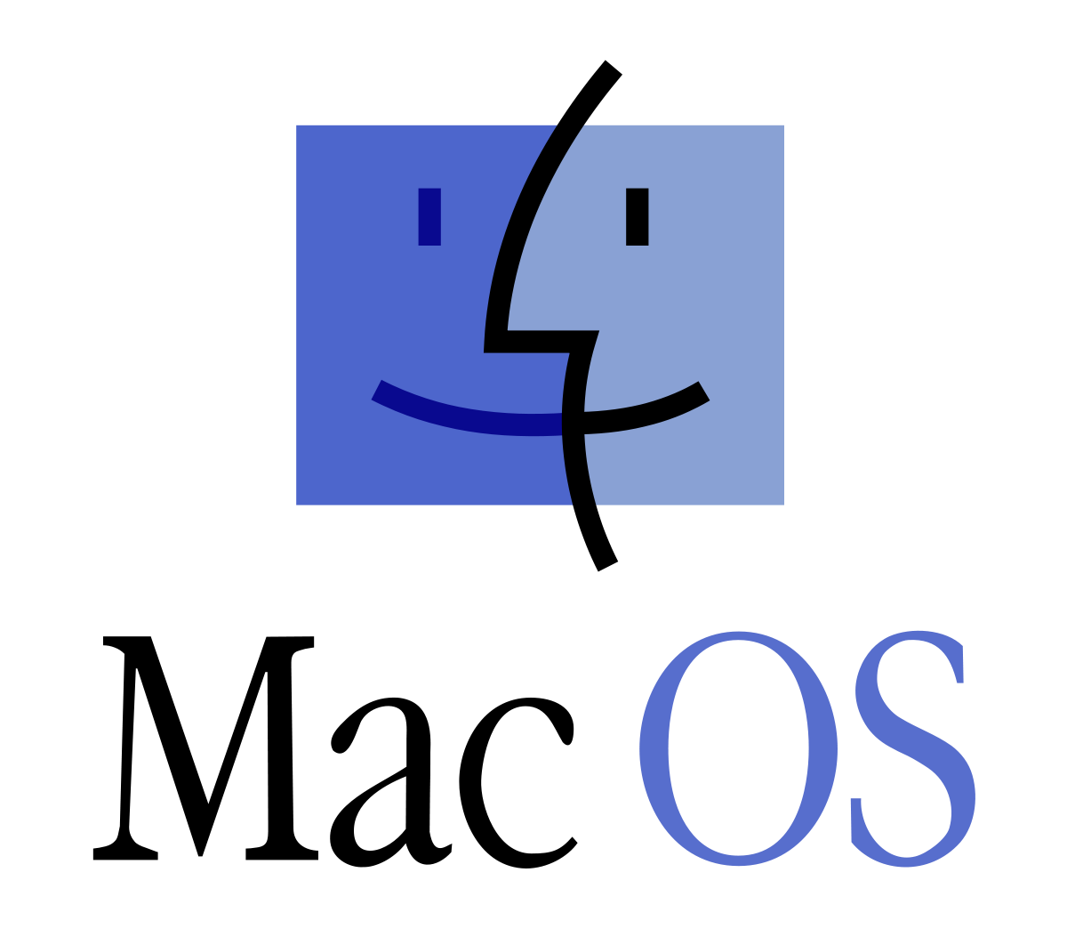
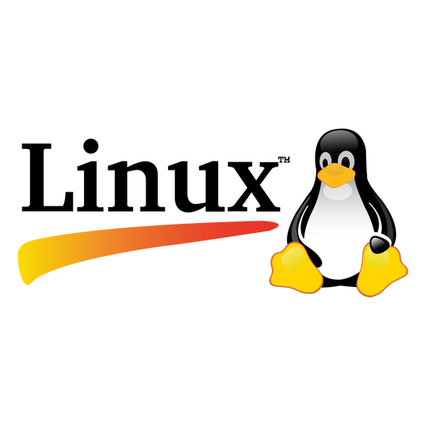
Matrix Linux Server
Accessing Matrix Using SSH on Windows 10, Mac OSX or Linux:
Open a terminal on Windows 10
From the start menu, type cmd and click on cmd icon to launch.
Open a terminal in macOS
Open Finder, go to Applications > Utilities, and click on the Terminal icon.
Open a terminal in Linux (CentOS)
From the main menu, choose Applications > System Tools > Terminal
In all three systems, on the command line:
Enter the following command: ssh senecausername@matrix.senecacollege.ca
Enter your password when prompted. (Answer yes to any questions it may ask you.)

Slide 24
Matrix Linux Server
Accessing Your Matrix Account:
You will need to provide the domain (host) name of the Matrix server, your username and password to access the Matrix server.
Your Matrix username and password is identical to your myseneca username and password.
NOTE: You can use the hostname matrix since you are located inside Seneca's network.
If you were located outside Seneca's network, then you would need to enter the full domain name: matrix.senecacollege.ca

Slide 25
Matrix Linux Server
Instructor Demonstration:
Your instructor will demonstrate how to connect to the Matrix server by issuing a command.

Slide 26
Matrix Linux Server
Alternative Method: Accessing Matrix Using SSH Application (Windows)
You can also install and run a free graphical SSH application in order to connect to your Matrix account. You may find it useful when running a graphical SSH application to copy and paste text.
Click the following link to download and install application on your Windows computer: https://the.earth.li/~sgtatham/putty/latest/w64/putty-64bit-0.76-installer.msi
After the application has been installed, it should appear in your Start menu. Look for PuTTY and open.
The main window will appear.

Slide 27
Matrix Linux Server
Instructor Demonstration:
Your instructor will demonstrate how to connect to the Matrix server by and installing and running an SSH application.

Slide 28
Matrix Linux Server
Accessing Your Matrix Account:
When connecting securely for the first time, a dialog box will appear to share a "public key" with your Matrix account in order to make your interaction between your workstation and the remote Linux server secure within the network (i.e. encrypted to prevent unauthorized access by other users).
Matrix has only a Command Line Interface (CLI)
The Matrix server has been configured to allow users to only interact with the Linux OS by issuing commands. There are various reasons for this, but the main 2 reasons are to force students to learn how to issue Linux commands as well as learning to combine Linux commands in a file called a shell script to automate common tasks.
Later in the course, your instructor may demonstrate other ways of accessing graphical versions of Linux, and how to launch a shell terminal.

Slide 29
Matrix Linux Server
Logging Out of Your Matrix Linux Account:
When you want to log-out of your Matrix server account, you can enter the commands exit, logout, or press the shortcut key: <ctrl><d>
NOTE: You should exit by issuing a command or shortcut key as opposed to closing the SSH application window.

Slide 30
Hands-on Time / HOMEWORK
Get Acquainted with the ULI101 WIKI, notes, tutorials and resources.
Perform the following investigations in Tutorial 1: INVESTIGATION 1: ACCESSING YOUR MATRIX LINUX ACCOUNT

